Slide 1
Disturbance Removed Compositing
Using LandTrendr to identify disturbances
Derek Olson
Remote Sensing Analyst
(925)876-3055
derekolson@fs.fed.us
Geospatial Technology and Applications Center | GTAC
USDA Forest Service

Slide 2
Talk about these things
Disturbance free imagery
What is LandTrendr
What does it do
How does it do it
Implementation in GEE
Image compositing
Leaf-off imagery
Percentiles
Harmonics

Slide 3
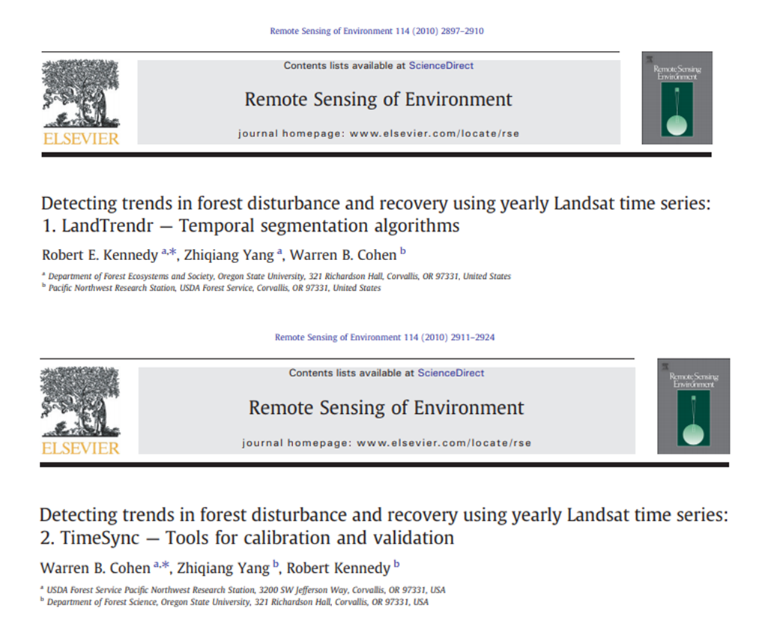
LandTrendr and TimeSync

Slide 4
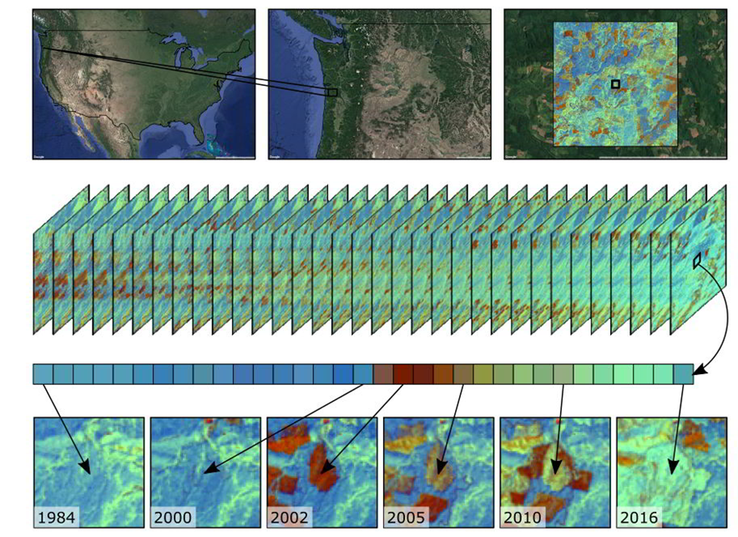
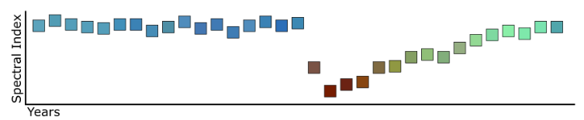
LandTrendr
What is LandTrendr?
Spectral-temporal segmentation algorithms
Useful for change detection in a time series of moderate resolution satellite imagery (primarily Landsat)

Slide 5
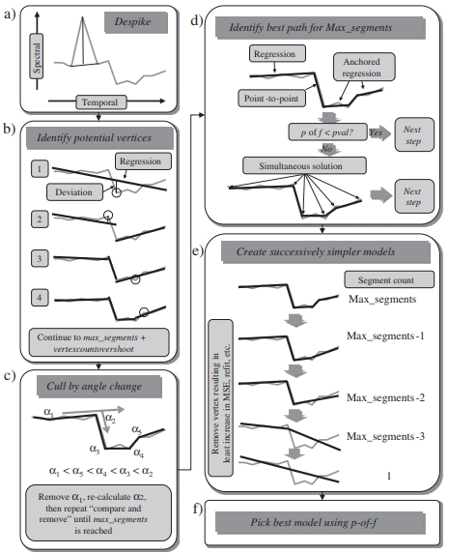
LandTrendr Segmentation Process
WHAT does LANDTRENDR do?
Creates a sequence of line segments that capture the broad features of the spectral trajectory, eliminating noise but without sacrificing necessary detail.
How does it do it?
Identifies a maximally-complex model of the trajectory
Iteratively simplifies the model
Chooses the best model based on simple fitting statistics
Removes change that is considered noise based on a vegetative cover criterion
Kennedy, Yang, Cohen (2010)

Slide 6


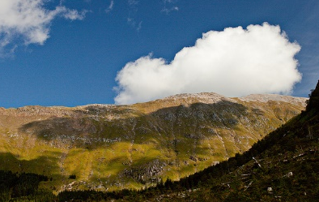
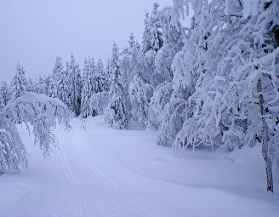
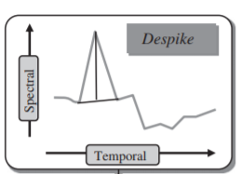
Spike Removal
Spikes in the data (e.g. residual clouds, snow, smoke, or shadows) are considered noise and are assumed to be ephemeral.
The despiking algorithm only removes spikes where the spectral value before and after the spike was similar.
The necessary degree of similarity is set by the despike control parameter.
The process is iterative, correcting only the worst spike at each iteration.
Spike
Before
After
Kennedy, Yang, Cohen (2010)

Slide 7
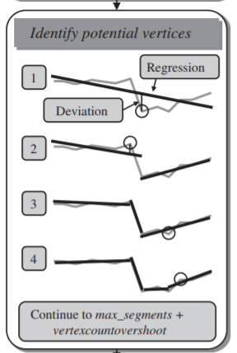
Identifying Vertices
A vertex in the time series is the [year, spectral value] combination that separates a distinct period before it from a distinct period after it. There are two strategies used to identify and then select vertices.
The first strategy is:
Regression-based vertex identification
Residual-error criterion to identify vertices
Kennedy, Yang, Cohen (2010)

Slide 8
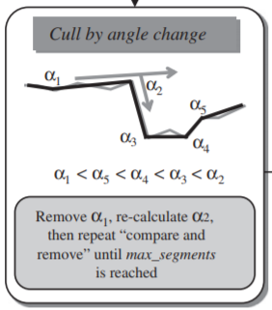
Identifying Vertices
Excess segments are removed using an angle criterion.
The vertex with the shallowest angle is removed, resulting in the elimination of one segment.
All vertex angles are recalculated.
Repeated until the segment count reached max_segments.

Slide 9
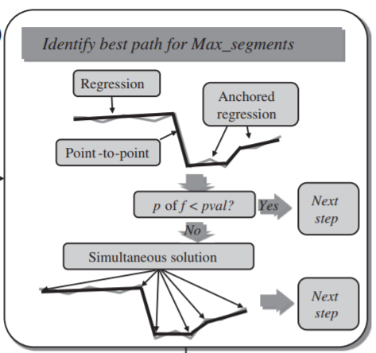
Fitting Trajectories
Fitting algorithms are used to determine the spectral values for each vertex year that would result in the best continuous trajectory through the time series.
Vertex algorithms in the prior section focused on the x-axis of the time series (identifying the years of breaks in the time series) while the trajectory-fitting algorithms honed the y-axis (the spectral values) given the x-axis vertex points.
Kennedy, Yang, Cohen (2010)

Slide 10
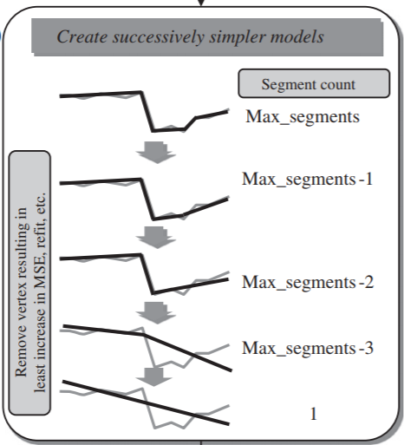
Simplifying the Model
Iteratively simplify the trajectory using successively fewer segments
Remove the weakest vertex
Recovery threshold
MSE criterion
Results in models of the trajectory for segment counts ranging from max_segments to 1

Slide 11

Determining the Best Model
The final step was to identify the best model using the p-value for the F-statistic.
Kennedy, Yang, Cohen (2010)

Slide 12
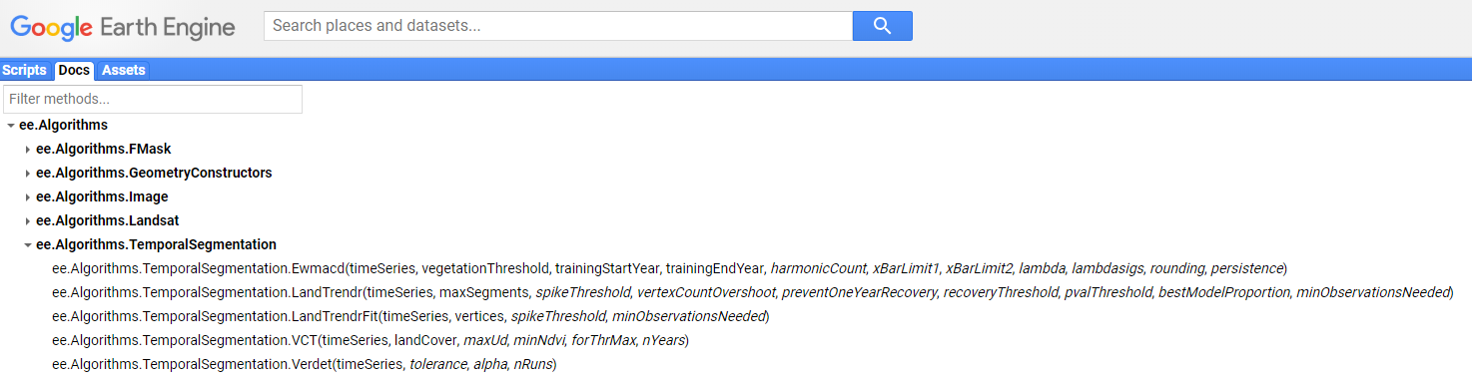
LandTrendr in GEE
Translation of the LandTrendr code into Google Earth Engine made it more accessible to the broader user community, and also led to some logic fixes.

Slide 13
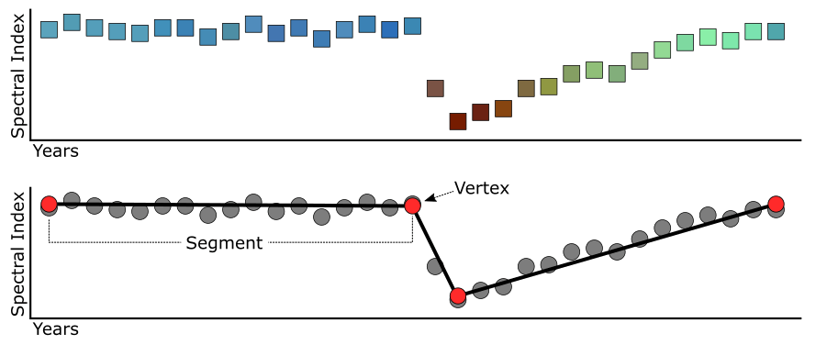
LandTrendr in GEE
NBR
Stable
Recovery
Decline
NBR values decrease with a loss of vegetation
Image source: https://emapr.github.io/LT-GEE/landtrendr.html

Slide 14
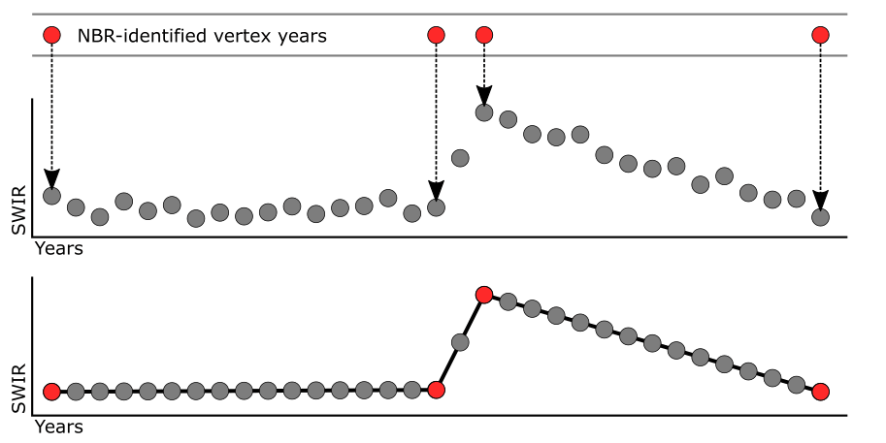
LandTrendr in GEE
LandTrendr in GEE requires a positive change in spectral value to be correlated with vegetation loss.
Recovery
Decline
Stable
NBR
NBR
Image source: https://emapr.github.io/LT-GEE/landtrendr.html

Slide 15
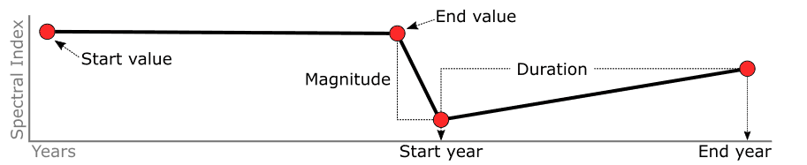
LandTrendr in GEE
Through segmentation we can make simple calculations about distinct spectral epochs.
Image source: https://emapr.github.io/LT-GEE/landtrendr.html

Slide 16
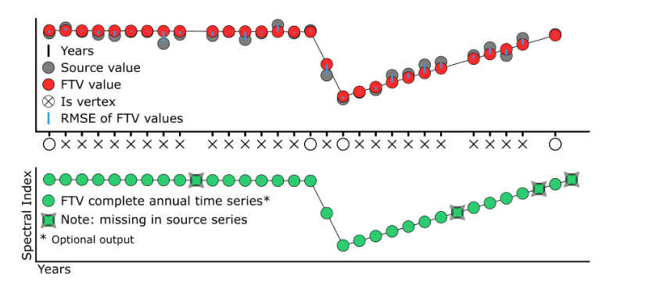
LandTrendr Outputs
The results of LT-GEE include:
The year of observations per pixel time series
The raw values
The fit to vertices (FTV) values
The root mean square error (RMSE) of the FTV values, relative to the source values
FTV values for additional bands in the collection greater than band 1 (optional)
Image source: https://emapr.github.io/LT-GEE/landtrendr.html

Slide 17
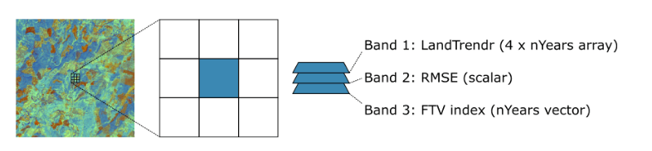
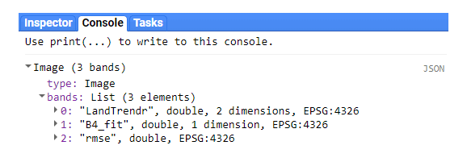
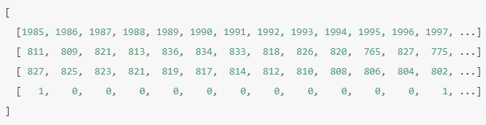
LandTrendr Outputs
The LandTrendr output
printed to the console
The output array
Image source: https://emapr.github.io/LT-GEE/landtrendr.html

Slide 18
Image Compositing
Landsat medoid composites

Slide 19
Composite Process
Filter Landsat data by collections, years and, Julian dates of interest
Apply cloud and shadow masking procedures
Get medoid pixel
Filtering
TOA or SR
Masking
Fmask
TDOM
Shadow shift
Reducing
Medoids are representative objects of a data set whose average dissimilarity to all the objects in the data set is minimal. Medoids are similar in concept to means or centroids, but medoids are always restricted to be members of the data set.
1984 – present
Growing season

Slide 20
Disturbance Removal
Filter Landsat data by collections, years and, Julian dates of interest
Apply cloud and shadow masking procedures
Get medoid pixel
Mask out pixels collected after disturbance
LandTrendr
MTBS
Time since disturbance

Slide 21
Ideas for getting leaf-off imagery

Slide 22
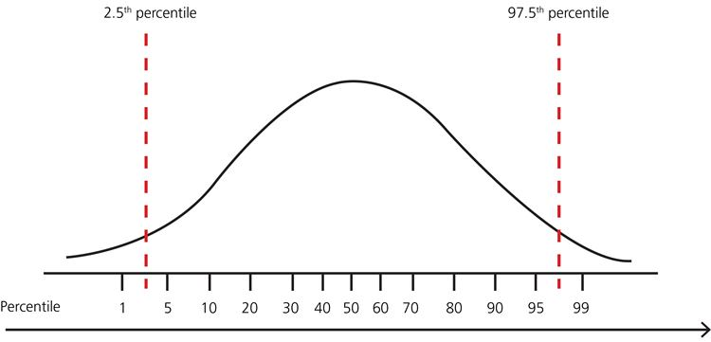
Percentiles
Filter Landsat data by collections, years and, Julian dates of interest
Apply cloud and shadow masking procedures
Get n^{th} percentile pixel
Can use full Landsat record (1984 – present)
Can choose the percentile
Simple method
For a band of interest (e.g. NDVI), get the n_{th} percentile value
Get the pixel value closet to the n_{th} percentile value
Mosaic using the pixel from the band of interest that is closest to the n_{th} percentile
This results in an image where each pixel can be from a different date, but a given pixel each band is from the same date
NDVI

Slide 23
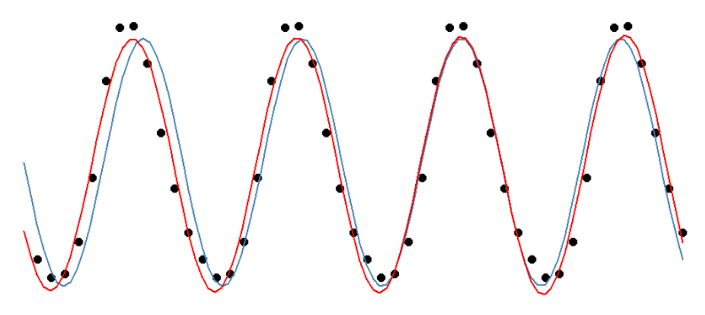
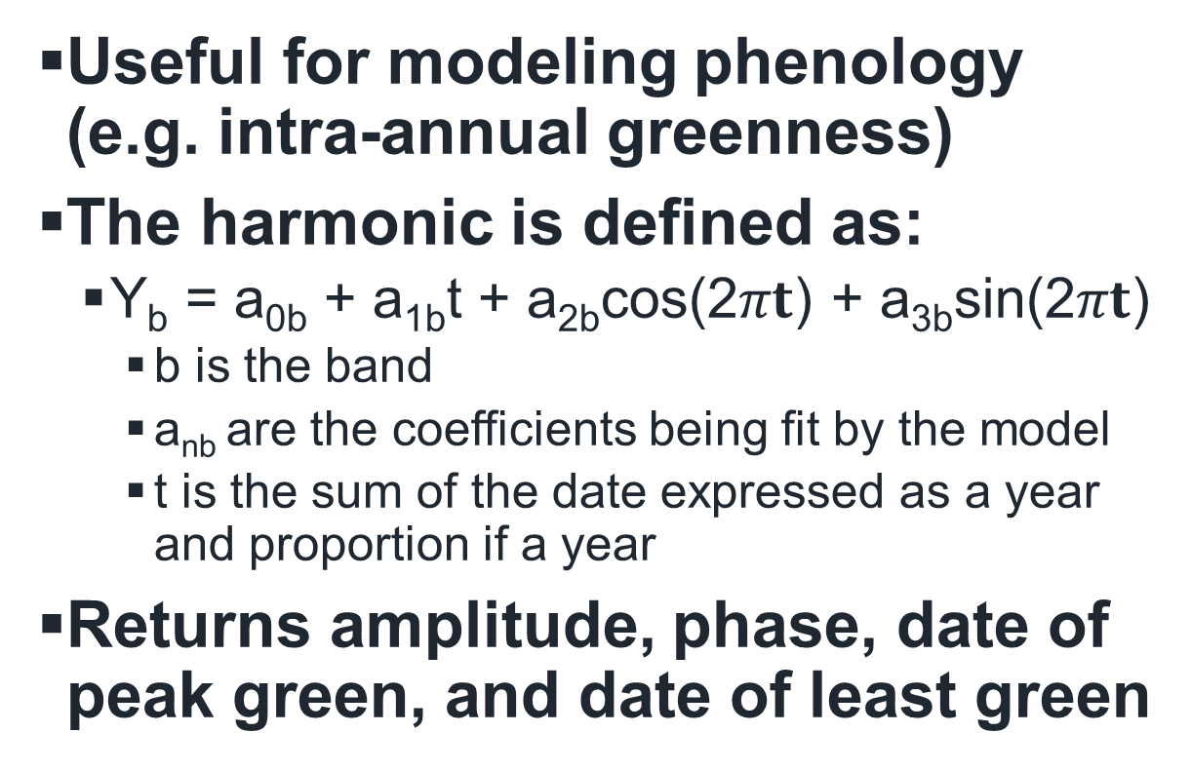
Harmonics
Useful for modeling phenology (e.g. intra-annual greenness)
The harmonic is defined as:
Y_{b} = a_{0b} + a_{1b}t + a_{2b}cos(2$πt$) + a_{3b}sin(2$πt$)
b is the band
a_{nb} are the coefficients being fit by the model
t is the sum of the date expressed as a year and proportion if a year
Returns amplitude, phase, date of peak green, and date of least green

Slide 24
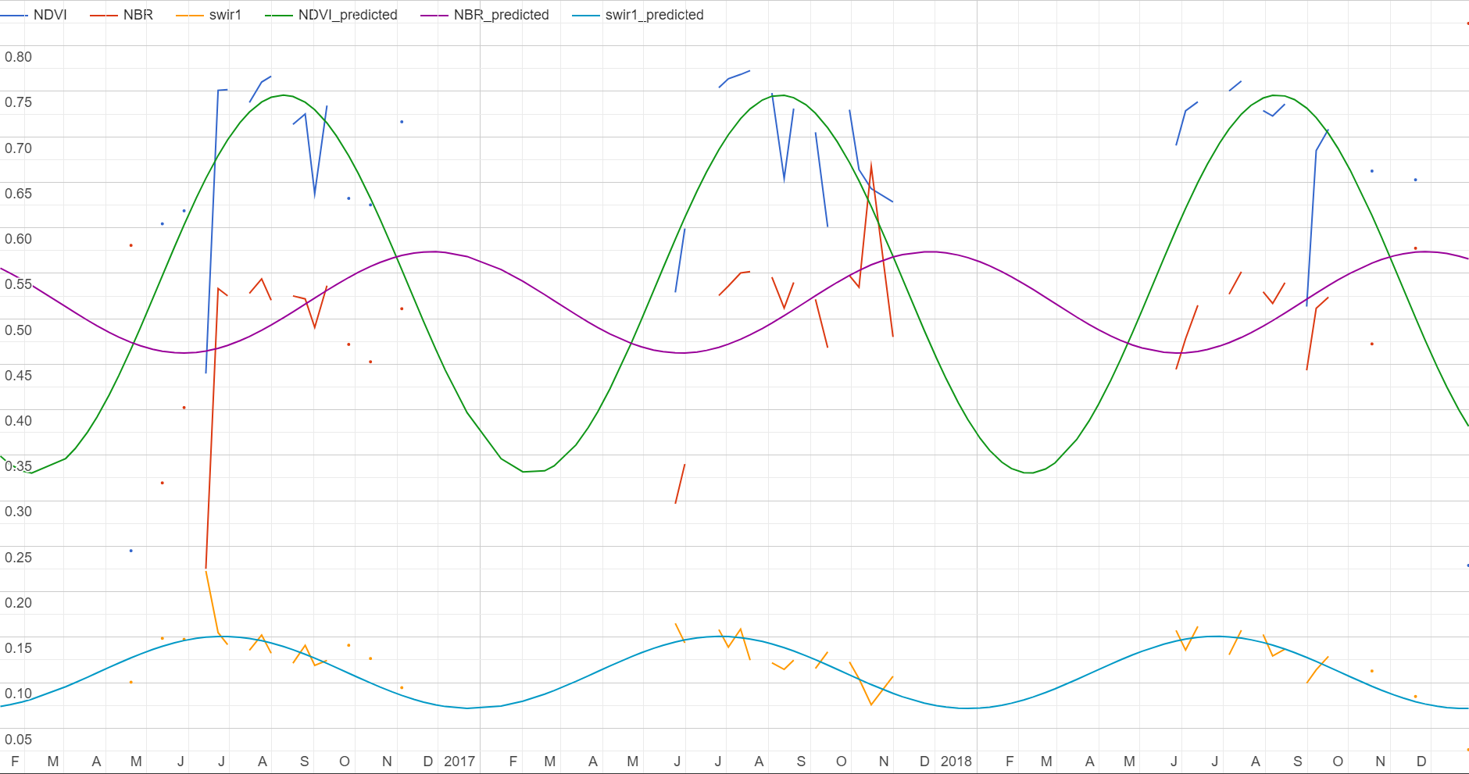
Harmonics
Predicted peak of green
Some #
of days
on either
side
Predicted date of least green

Slide 25
Harmonics – Potential Limitations
More complicated to explain
Need to determine a threshold
# of days on either side of date of least green
Could be done regionally
Can only incorporate last 3 to five years of data
This is because it is computationally intensive
Data hungry
In cloudy/snowy areas data may be lacking

Slide 26
Questions?
Derek Olson
Remote Sensing Specialist,
(925)876-3055
derekolson@fs.fed.us
Geospatial Technology and Applications Center | GTAC
USDA Forest Service

